Slide 1
Deterministic
Finite Automata
And Regular Languages
(Some slides taken from a deck by Costas Busch at RPI)

Slide 2
Deterministic Finite Automaton (DFA)
Input Tape
String
Output
“Accept”
or
“Reject”
Finite
Automaton

Slide 3
Transition Graph
initial
state
accepting
state
transition
state

Slide 4
Alphabet
For every state, there is a transition
for every symbol in the alphabet

Slide 5
Initial Configuration
head
Input Tape
Input String
Initial state

Slide 6
Scanning the Input

Slide 9
Input finished
accept

Slide 10
A Rejection Case
Input String

Slide 13
Input finished
reject

Slide 14
Another Rejection Case
Tape is empty
Input Finished
reject

Slide 15
Language Accepted:

Slide 16
To accept a string:
all the input string is scanned
and the last state is accepting
To reject a string:
all the input string is scanned
and the last state is non-accepting

Slide 17
Another Example
Accept
state
Accept
state
Accept
state

Slide 18
Empty Tape
Input Finished
accept

Slide 19
Another Example
Accept
state
trap state

Slide 20
Input String

Slide 23
Input finished
accept

Slide 24
A rejection case
Input String

Slide 27
Input finished
reject

Slide 28
Language Accepted:

Slide 29
Another Example
Alphabet:
Language Accepted:

Slide 30
Formal Definition
Deterministic Finite Automaton (DFA)
: set of states
: input alphabet
: transition function
: initial state
: set of accepting states

Slide 31
Set of States
Example

Slide 32
Input Alphabet
:the input alphabet never contains
Example

Slide 33
Initial State
Example

Slide 34
Set of Accepting States
Example

Slide 35
Transition Function
Describes the result of a transition
from state with symbol

Slide 36
Example:

Slide 39
Transition Table for
symbols
states

Slide 40
Extended Transition Function
Describes the resulting state
after scanning string from state

Slide 41
Example:

Slide 44
Special case:
for any state

Slide 45
In general:
implies that there is a walk of transitions
states may be repeated

Slide 46
Language Accepted by DFA
Language of DFA :
it is denoted as and contains
all the strings accepted by
We say that a language
is accepted (or recognized)
by DFA if

Slide 47
For a DFA
Language accepted by :

Slide 48
Language rejected by :

Slide 49
More DFA Examples
Empty language
All strings

Slide 50
Language of the empty string

Slide 51
= { all strings with prefix }
accept

Slide 52
= { all binary strings containing
substring }

Slide 53
= { all binary strings without
substring }

Slide 55
Regular Languages
Definition:
A language is regular if there is
a DFA that accepts it ( )
The languages accepted by all DFAs
form the family of regular languages

Slide 56
Example regular languages:
{ all strings in {a,b}* with prefix }
{ all binary strings without substring }
There exist automata that accept these
languages (see previous slides).

Slide 57
There exist languages which are not Regular:
There is no DFA that accepts these languages
(we will prove this in a later class)

Slide 58
The Firing Squad Problem
Five “soldiers” all start in the sleep state. You change the one on the left to the wake state.
All five must get to the fire state at the same time (for the first time).
sleep
wake
fire
sleep
wake
fire
sleep
wake
fire
sleep
wake
fire
sleep
wake
fire
sleep
wake
fire
sleep
wake
fire
sleep
wake
fire
sleep
wake
fire
sleep
wake
fire

Slide 59
Shorthand
Means use this transition when your left neighbor is in any state at all and your right neighbor is in state a,b, or d.

Slide 60
{sleep,fire,end},Q
sleep
{w},Q
{w3},Q
{w4},Q
{w2},Q
wake
wake2
wake3
wake4
Q,Q
Q,Q
Q,Q
Q,Q
fire!
 | 1 | 2 | 3 | 4 | 5
 | sleep | sleep | sleep | sleep | sleep
 | sleep | sleep | sleep | sleep | sleep
 | sleep | sleep | sleep | sleep | sleep
 | sleep | sleep | sleep | sleep | sleep
 | sleep | sleep | sleep | sleep | sleep

Slide 61
{sleep,fire,end},Q
sleep
{w},Q
{w3},Q
{w4},Q
{w2},Q
wake
wake2
wake3
wake4
Q,Q
Q,Q
Q,Q
Q,Q
fire!
 | 1 | 2 | 3 | 4 | 5
 | wake | sleep | sleep | sleep | sleep

Slide 62
{sleep,fire,end},Q
sleep
{w},Q
{w3},Q
{w4},Q
{w2},Q
wake
wake2
wake3
wake4
Q,Q
Q,Q
Q,Q
Q,Q
fire!
 | 1 | 2 | 3 | 4 | 5
 | wake | sleep | sleep | sleep | sleep
 | wake2 | wake2 | sleep | sleep | sleep

Slide 63
{sleep,fire,end},Q
sleep
{w},Q
{w3},Q
{w4},Q
{w2},Q
wake
wake2
wake3
wake4
Q,Q
Q,Q
Q,Q
Q,Q
fire!
 | 1 | 2 | 3 | 4 | 5
 | wake | sleep | sleep | sleep | sleep
 | wake2 | wake2 | sleep | sleep | sleep
 | wake3 | wake3 | wake3 | sleep | sleep

Slide 64
{sleep,fire,end},Q
sleep
{w},Q
{w3},Q
{w4},Q
{w2},Q
wake
wake2
wake3
wake4
Q,Q
Q,Q
Q,Q
Q,Q
fire!
 | 1 | 2 | 3 | 4 | 5
 | wake | sleep | sleep | sleep | sleep
 | wake2 | wake2 | sleep | sleep | sleep
 | wake3 | wake3 | wake3 | sleep | sleep
 | wake4 | wake4 | wake4 | wake4 | sleep

Slide 65
{sleep,fire,end},Q
sleep
{w},Q
{w3},Q
{w4},Q
{w2},Q
wake
wake2
wake3
wake4
Q,Q
Q,Q
Q,Q
Q,Q
fire!
 | 1 | 2 | 3 | 4 | 5
 | wake | sleep | sleep | sleep | sleep
 | wake2 | wake2 | sleep | sleep | sleep
 | wake3 | wake3 | wake3 | sleep | sleep
 | wake4 | wake4 | wake4 | wake4 | sleep
 | fire | fire | fire | fire | fire

Slide 66
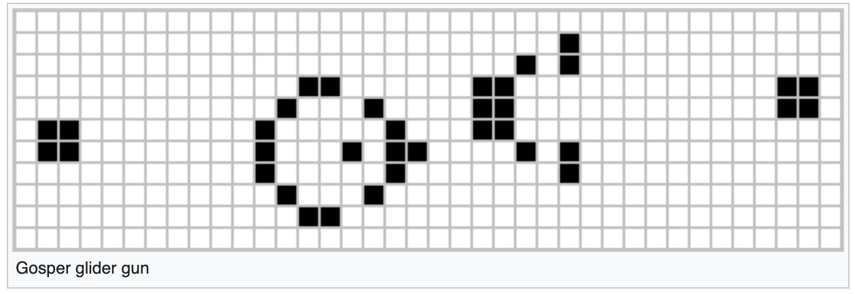
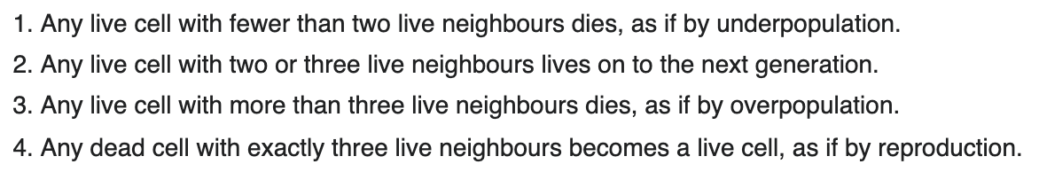
Conway’s Game of Life
Rules:
Link-To-Animation
Link to Youtube-video

